Slide 1


What should I Read Next?
A book recommendation engine based on GoodReads Reviews and Ratings
Presentation by:
Rishika, Nia, Rahul & Dheeraj

Slide 2

Contents
01
Introduction and Objective
Exploratory Data Analysis
02
05
About the Dataset
Model Development
03
06
Data Cleaning & Preprocessing
Output, Conclusion & Scope
04

Slide 3

THE BOOK LOVER’S DILEMMA
Problem Statement
Identify genres of books and implement a hybrid recommendation engine for better user experience
Objective
Develop a hybrid book recommendation system using collaborative filtering and content-based methods, considering user preferences, historical interactions, and genres for accurate and diverse recommendations

Slide 4
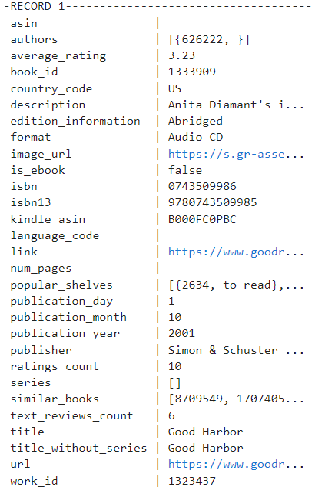
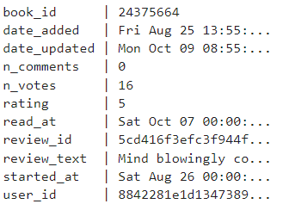

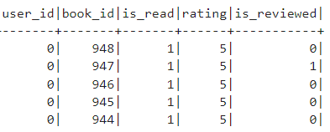
Data - Outlook
REVIEWS
#records: ~15.7 M
Size: 15.6 GB
METADATA
#records: ~2.4 M
Size: 4.6 GB
INTERACTIONS
#records: ~228 M
Size: 4 GB

Slide 5
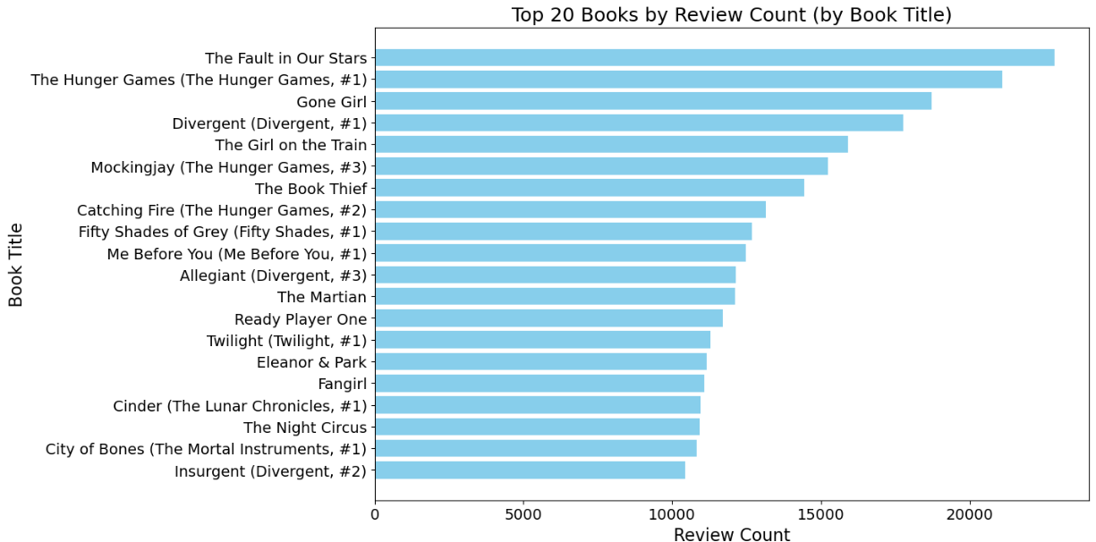
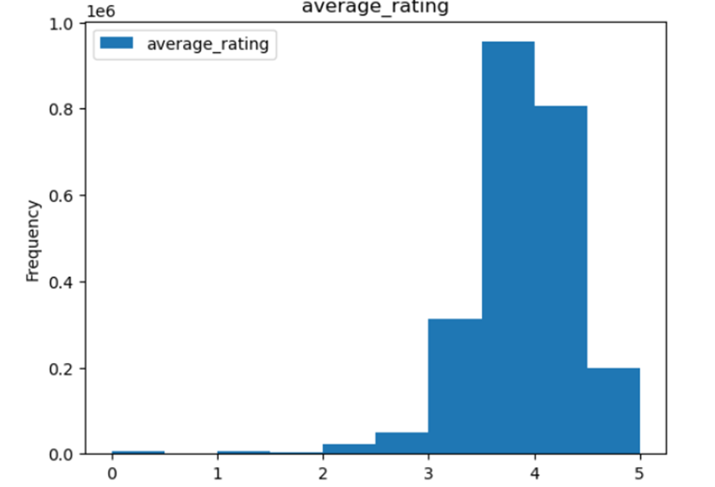
How are books being rated..?
Most of the books on Goodreads have a rating between 3.5 and 4.5.

Slide 6
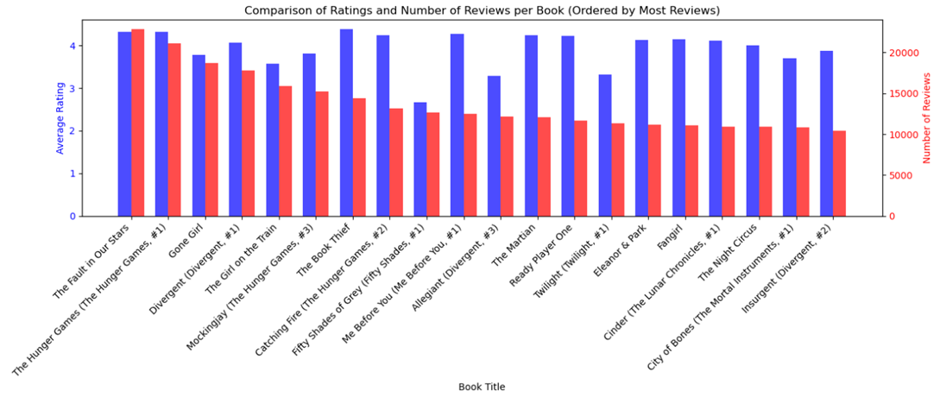
Ratings and Review for the Most Popular Books

Slide 7
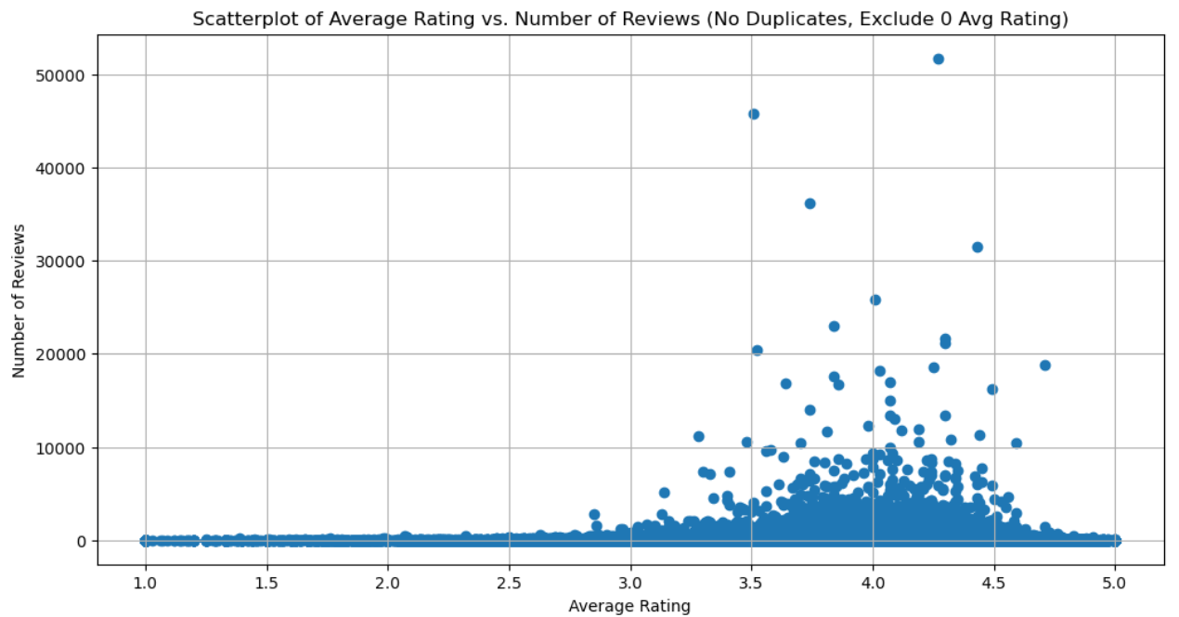
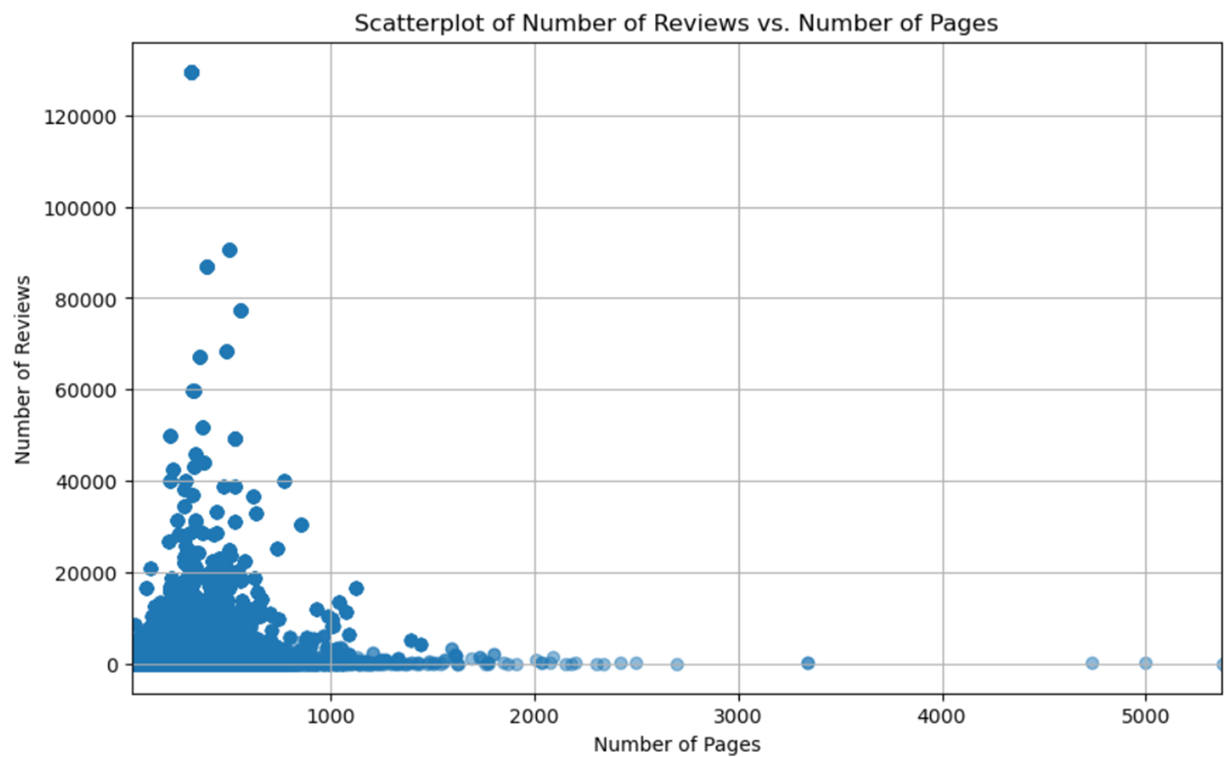
User Reading Patterns
Books with average number of pages around 250 receive higher number of reviews.
Books with higher ratings also tend to receive more reviews from readers.

Slide 8
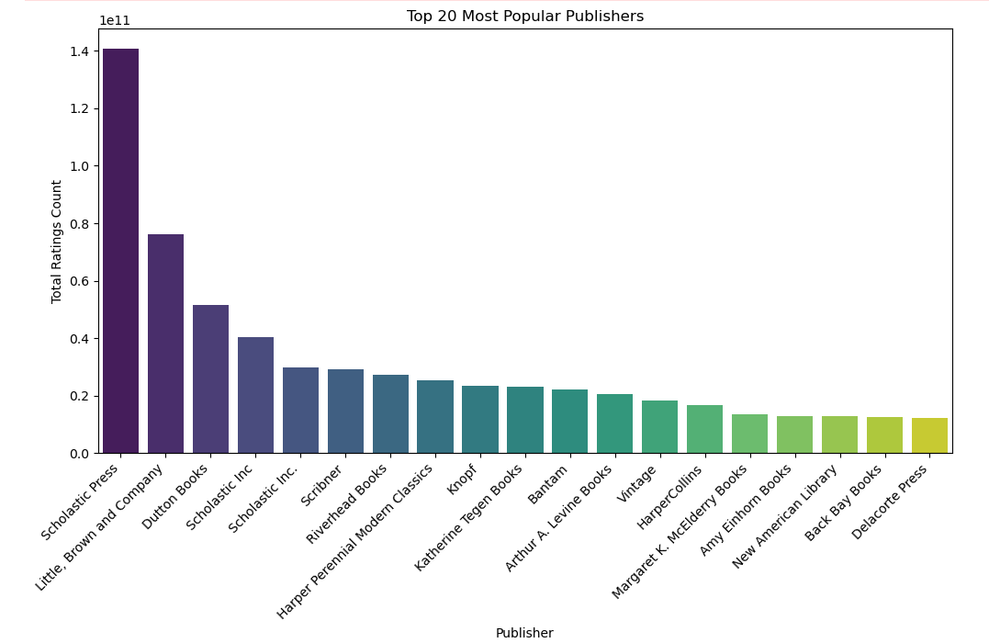
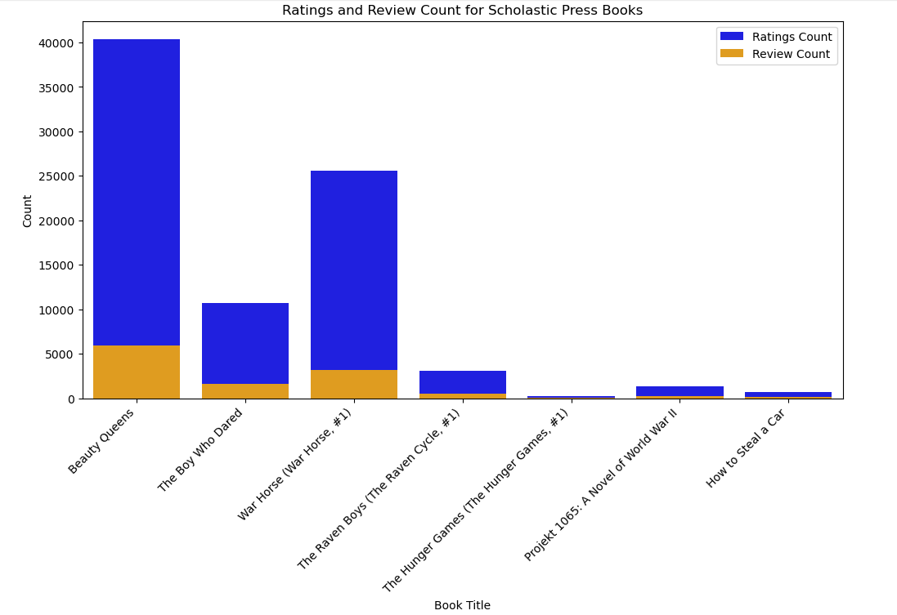
Stochastic Press is the Top Performing Publisher

Slide 9
Data Cleaning and Preprocessing
Non-English books
# Books dropped: ~450 K
Missing titles & descriptions
# Books dropped: ~410 K
Faulted Interactions
# Interactions dropped: ~284 K

Slide 10
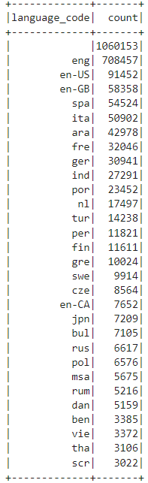
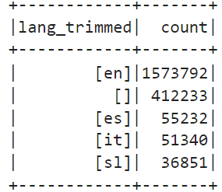
Genre Identification - Handling Missing Language Code
~1M Missing Values (43%)
Purpose of Clustering - Identify salient genres of books for building a hybrid recommendation system.
K-Means clustering is chosen for its ability to group similar items based on features, making it ideal for genre identification instead of Gaussian clustering.
Utilized a pre trained language decoder (LanguageDetectorDL) to identify and extract the language from book with missing descriptions.
Ensures clustering is performed on English descriptions only, maintaining consistency in the analysis.
~858k English Books
LanguageDetectorDL Results

Slide 11
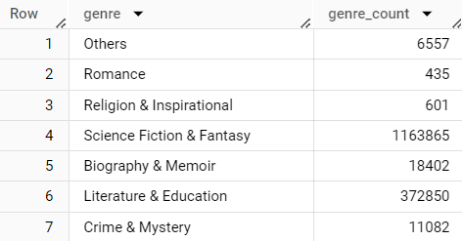
Genre Identification - Clustering
Preprocessing Pipeline of Description
Tokenization
Stopwords Removal
URL & Symbols Removal
Vectorized Text (TF-IDF)
Clustering (KMeans)
K-means partitions data into k clusters based on similarity.
Represent the text documents as numerical vectors using techniques like TF-IDF.
Computed the silhouette score for different values of k and choose the one with the highest score.
The final clusters acquired represent the book genres employed in content-based filtering for hybrid recommendation systems.
(Silhouette Score = 0.401)
Clusters = 7

Slide 12
Hybrid Recommendation Model - Overview
Popularity Based
A recommendation technique that suggests items based on their popularity or, more precisely, their frequency of being chosen or interacted with by users.
Popularity Filtering is implemented for new users with no prior interaction
Collaborative Filtering
This approach uses ALS algorithm to recommend books based on patterns it has identified in the user-item interactions by analyzing the behavior of users and identifying latent factors that represent their preferences.
70% weightage is given to results from this model
Content-Based
This approach recommends books based on the content of the items themselves. It analyzes the genre of the books, and matches them with the user's preferences.
30% weightage is given to results from this model

Slide 13

Hybrid Recommendation Model - Highlights
Popularity Based Filtering - New Users:
→ Popularity score assigned as an aggregate of number of ratings and average rating for that book
Collaborative Filtering using ALS algorithm - Existing Users:
→ Normalized Ratings to account for different user rating criterias
→ Custom strategic train-test split
→ Custom randomized search for Hyperparameter Tuning
→ Randomized prediction strategy to account for volume of user - unread books
→ RMSE: 0.23
Content-Based Filtering - Existing Users:
→ User preferences for genre is counted through average rating for user genre combinations
→ Genre information is taken from clustering algorithm
Overall Output: (0.7 * rating from ALS) + (0.3 * rating from content based filtering)

Slide 14
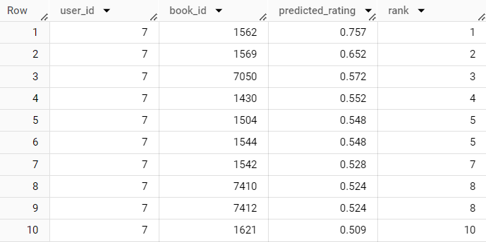
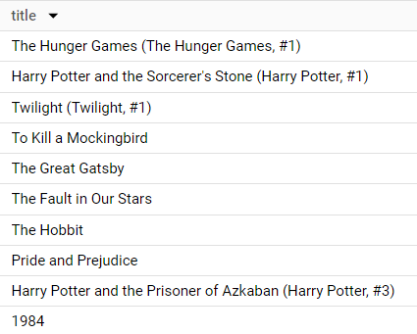
Hybrid Recommendation System - Output
Popularity Based Filtering
Hybrid Recommendation Output

Slide 15
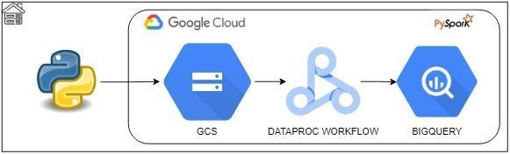
Cloud Pipeline and Architecture
The final solution is a Jupyter notebook which has the following parts:
Push any updated data from local to GCS
Instantiate Dataproc Workflow Template that reads data from GCS and writes the outputs to BigQuery.
Scheduling: Cronjobs/ Google cloud scheduler can be used to schedule the execution of this notebook
Cost Estimation: Current architecture estimates to around $100 per execution

Slide 16
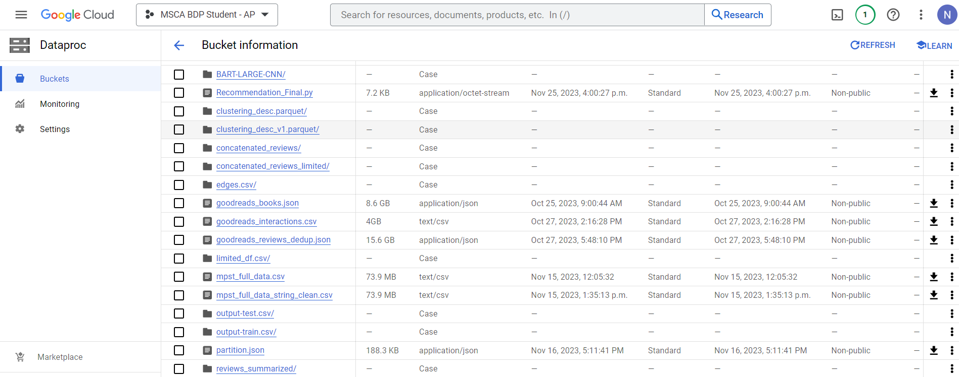
Google Cloud Components (1/4) - GCS (Bucket: msca-bdp-project-goodreads)

Slide 17
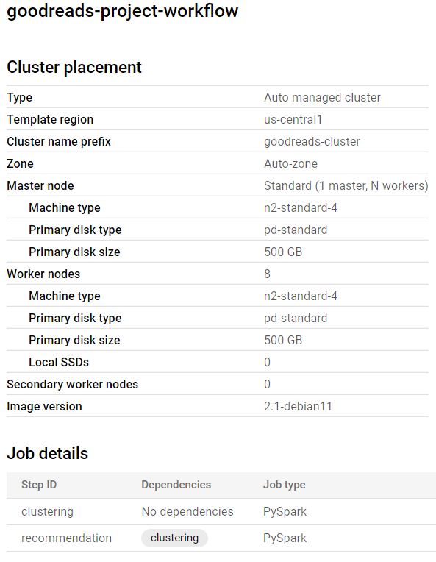

Google Cloud Components (2/4) -
Dataproc Workflow Template
Clustering is added as a dependency to recommendation as it makes use of the genres predicted.
This workflow can be initiated by any of the following -
Console
Terminal
Programmatically through Python

Slide 18

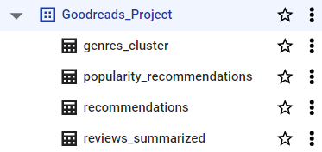
Google Cloud Components (3/4) - BigQuery
Results are written to BigQuery as it is easy to query them due to its SQL based dialect.
It also has in-built ML capabilities that one can make use of to utilize the results in further model development.

Slide 19
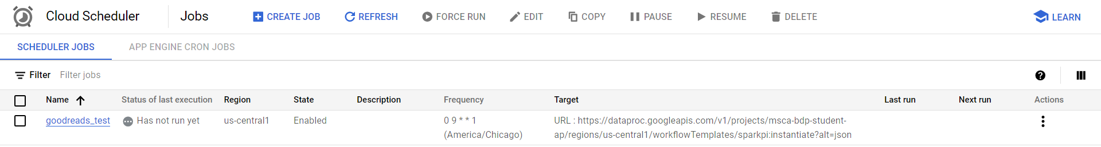
Google Cloud Components (4/4) - Scheduler
The pipeline can be scheduled in majorly 2 ways:
Google Cloud Scheduler (involves cost)
Cron Job (cost free solution)
On windows - using task scheduler
On linux based machines - using crontab command

Slide 20

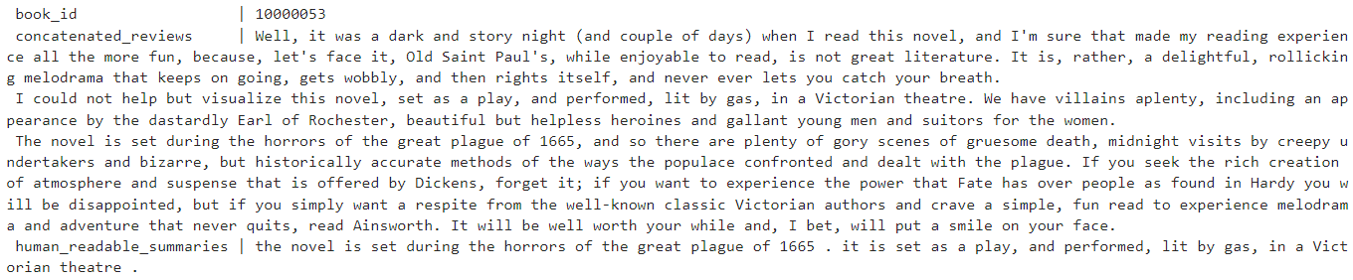
Reviews Summarization - T5 Small Pre Trained Model
This summarizes all the reviews for a book and gives a summary which is helpful to understand what users think about it.
Makes use of T5 small model and includes Document Assembler, T5 Transformer and finisher in the pipeline.

Slide 21
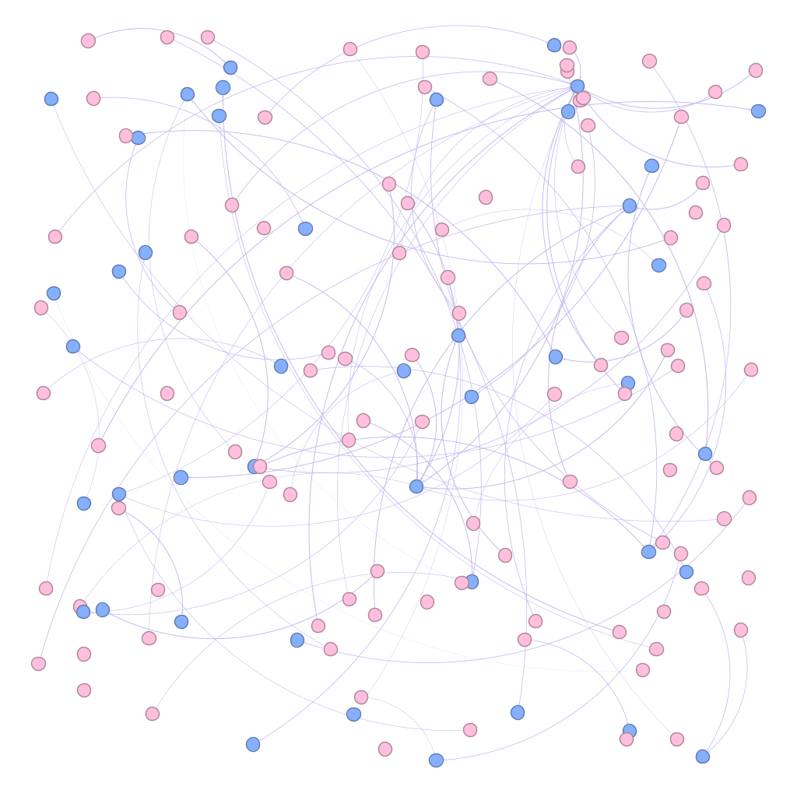
Graph Frames
A graph frame visualization for the user-book interaction.
Pink nodes represent users, and blue nodes represent books.
Number of Vertices: 3,176,248
Number of Edges: 112,131,203

Slide 22
Future Work - Scope
FAKE REVIEWS DETECTION
Critical for a reliable and fair ecosystem for users, authors, and publishers. It contributes to the overall health of the platform by promoting authenticity.
COMMUNITY DETECTION
Understanding user communities can help in targeted marketing strategies and improve collaborative filtering
IDENTIFY TRENDING BOOKS AND AUTHORS
Identify trending books and authors based on recent user activity, ratings, and reviews
RARITY AND UNIQUENESS RECOMMENDATIONS
It seeks out hidden gems and literary treasures that might not be on the user's radar and help them explore niche genres
ADD NODES TO GRAPH FRAME
Add nodes for authors and publishers; to better understand the relation between users, books, authors and publishers
SENTIMENT ANALYSIS ON REVIEWS
Understand the sentiment and opinions expressed by users towards specific books

Slide 23

THANK YOU

Slide 24

APPENDIX

Slide 25
Data - Quick Facts
# of Users: 465323
# of books: 2080190
# of reviews: 15739967
# of languages: 26
Range of published years: 1989 to 2014

Slide 26

Q & A

